Slide 1
INU 211
Unit 10

Slide 2
¡OJO!
You will have the following on Thursday, September 15!
Unit 10 Quiz (escrito)
Unit 9 and 10 Quiz (oral)

Slide 3
present | simple past | present perfect (use with have/has)
be | was/were | 1.________________
do | 2.__________ | done
eat | ate | 3._____________
4._______ | went | gone
have | had | 5.______________
6._______ | made | made
ride | rode | 7._______________
see | 8._____________ | seen
drive | drove | 9.______________
fly | flew | 10._____________
read | read | 11.______________
write | wrote | 12._______________
sing | sang | sung
lose | lost | lost
get | got | gotten
been
did
eaten
go
had
make
ridden
saw
driven
flown
read
written

Slide 4
Past or Past Participle?
Have you ever ____________ your math book?
lost
lose

Slide 5
Past or Past Participle?
Two days ago, I ________ a hamburger.
eat
eaten
ate

Slide 6
Past or Past Participle?
Paul _________ a Starbucks coffee on his way to work this morning.
drunk
drank

Slide 7
Past or Past Participle?
Have you ever _______ a Starbucks coffee?
drunk
drank

Slide 8
Past or Past Participle?
Have you ______ the movie “Titantic” before?
seed
saw
seen

Slide 9
Past or Past Participle?
I _______ a movie at the theatre with my girlfriend last weekend.
seed
saw
seen

Slide 10
Past or Past Participle?
What verb could go in the blank?
Have you _____________ to New Orleans?
(ever) been

Slide 11
Past or Past Participle?
What verb could go in the blank?
I ________ the city bus to school today.
rode

Slide 12
Past or Past Participle?
What verb could go in the blank?
Sara has ________ the city bus her entire life.
ridden

Slide 13
Past or Past Participle?
What verb could go in the blank?
I ________ to Buenos Aires last summer.
went
flew

Slide 14
Past or Past Participle?
What verb could go in the blank?
I’ve _______ to Buenos Aires many times in the past.
gone
flown
been

Slide 15
Writing
Activity 8 • Word Power, p. 68
Write a logical sentence using the verb and one of the items listed.

Slide 16
for and since
p. 67
How long did you live in Thailand?
I lived there for two years. It was wonderful.
How long have you lived in Miami?
I’ve lived here for six months.
I’ve lived here since last year.

Slide 17
for and since
expressions with for | expressions with since
la duración del tiempo two weeks a few months several years a long time | desde el principio de un período de tiempo 6:45 last weekend 1997 elementary school

Slide 18
Activity 5, p. 66
Decide whether each sentence should have for or since.

Slide 19
Question and Answer
own this book
study English
know your best friend
live in Concepción
be a student
work at your job
How long have you…?

Slide 20
Review

Slide 21
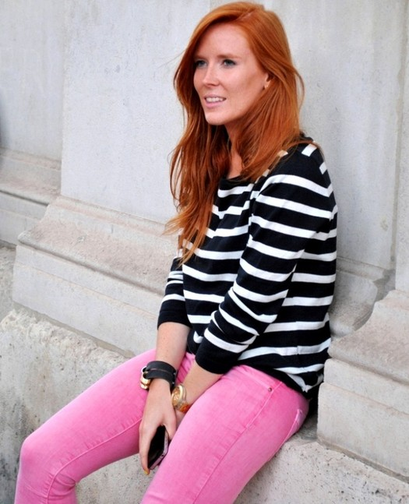
Practice Questions for Oral Quiz
UNIT 9
Describing people — p. 59
What does she look like?
Does she wear glasses?
How old is she?
How tall is she?
Describe her hair.
Name two things she’s wearing.

Slide 22
Practice Questions for Oral Quiz
sing in a karaoke bar
go to an Internet café
try mountain biking
go ice-skating
see a live concert
eat Korean food
climb a mountain
drink Starbucks coffee
drive a sports car
ride a camel
UNIT 10
Jan has several goals in life. Ask her if she has completed them. (At least 3.)
Tell her which of her goals you’ve completed. (At least 3.)

Slide 23
Reading 12
Which interview describes which picture?

Slide 24
¡OJO!
You will have the following on Thursday, September 15!
Unit 10 Quiz (escrito)
Unit 9 and 10 Quiz (oral)

