Slide 1
Tourism
Aaron McGrath
aaronyraquel@yahoo.cl

Slide 2
Review

Slide 3
present | simple past | present perfect (use with have/has)
be | was/were | been
do | did | done
eat | ate | eaten
go | went | gone
have | had | had
make | made | made
ride | rode | ridden
see | saw | seen
drive | drove | driven
fly | flew | flown
read | read | read
write | wrote | written

Slide 4
Present Perfect vs. Simple Past
Present Perfect | Simple Past
An indefinite time in the past. example: Have you ever eaten Korean food? Yes, I have. | Specific time/event in the past. example: I ate it once.

Slide 5
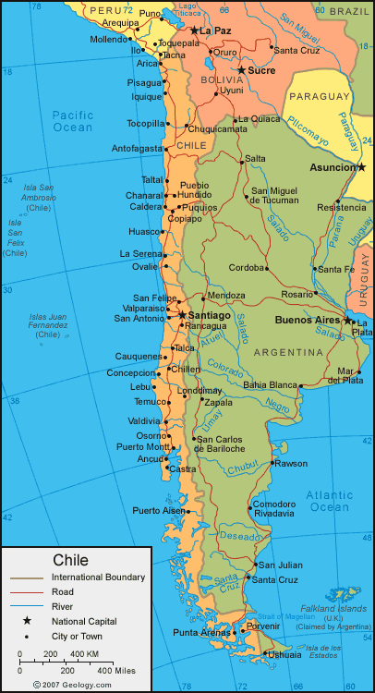
Yes, I’ve been to… or No, I haven’t been to…

Slide 6
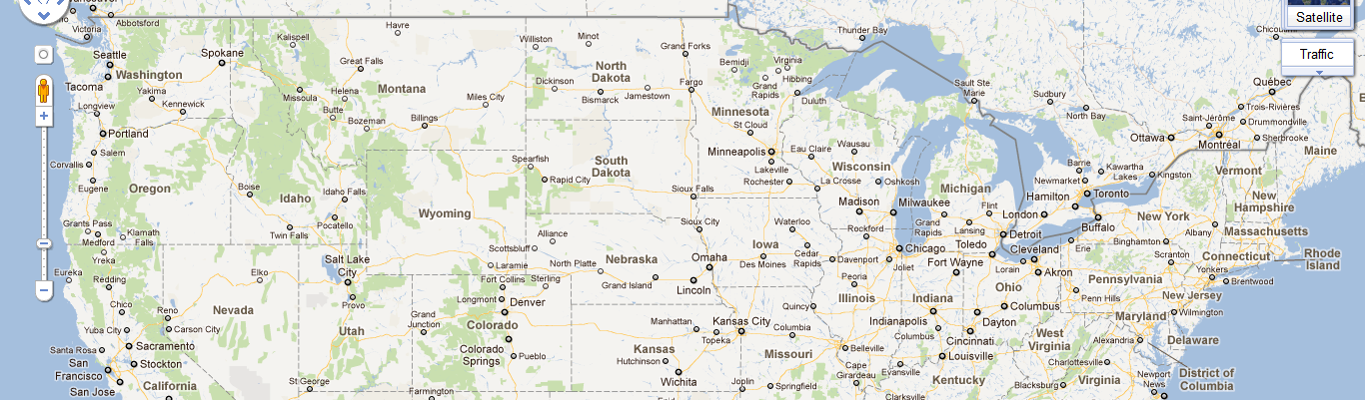
Have you ever…?

Slide 7
Song: Have You Ever? • Artist: Brandy • Genre: R&B • Year: 1998
PLAY
[Chorus] Have you ever 1.__________ somebody so much it makes you cry Have you ever 2. ___________ something so bad you can't sleep at night Have you ever 3.___________ to find the words but they don't come out right Have you ever, have you ever Have you ever 4.___________ in love, been in love so bad you'd do anything to make them understand Have you ever 5.____________ someone steal your heart away you'd give anything to make them feel the same Have you ever 6._____________ for the words to get you in their heart But you don't know what to say, and you don't know where to start [Chorus] Have you ever 7. _______________ the one you've 8.__________ of all of your life You'd do just about anything to look into their eyes Have you finally found the one you've 9. _________ your heart to only to find that one won't give their heart to you Have you ever 10. _______________ your eyes and dreamed that they were there And all you can do is wait for the day when they will care [Chorus]
loved
needed
tried
been
had
searched
found
dreamed
given
closed

Slide 8
Unit 11

Slide 9
travel and the Internet
VIDEO – Hotwire
“Nearly 37 million Internet users have purchased travel products online.”
Have you ever purchased travel services online?
What are the advantages? What are the disadvantages?

Slide 10
My trip to Chile
Cheap-O
* 2. Chicago, Illinois (ORD) Chicago O’Hare
* 1. Springfield, Missouri (SGF)
Springfield/Branson Regional Airport
3. Miami, Florida (Miami) *
Miami International Airport

Slide 11
* 4. Bogotá, Colombia (BOG)
* 5. Santiago, Chile (SCL)

Slide 12
Booking terms & conditions p. 96
Cancellations
Booking Changes
Compulsory Insurance
Flight Delays
If we change your holiday before you leave
If we make changes after you have booked your holiday
Your holiday price

Slide 13
“If” statements
If describes a situation or event that is conditional.
Condition
present simple (you go)
present continuous (you’re going)
present perfect (you’ve gone)
If +
Consequence
future (can, will, may might, must, should)
CONDITION
If you decide to stay for longer than a month, we will offer a discount.
CONSEQUENCE

Slide 14
“If” statements
If describes a situation or event that is conditional.
Condition
present simple (you go)
present continuous (you’re going)
present perfect (you’ve gone)
If +
Consequence
future (can, will, may might, must, should)
CONDITION
CONSEQUENCE
If you cancel your trip, you can only receive a 50 percent refund on your ticket.

Slide 15
“IF” STatements
Match the if statements on Act. 2, p. 97

Slide 16
Practice
With a partner, create a scenario in which a customer calls in to ask questions about the terms and conditions of an airline reservation.
Have at least 5 questions and answers that use if statements.
Person A: Travel Agent
Person B: Customer

